Slide 1
Jane Austen
IGCSE
English Literature

Slide 2
Biography
Jane Austen was born on 16th December 1775, at Steventon in Hampshire, where her father, the Rev. George Austen, was rector.
Her mother was Cassandra Leigh.
Jane Austen died on July 18th, 1817.

Slide 3
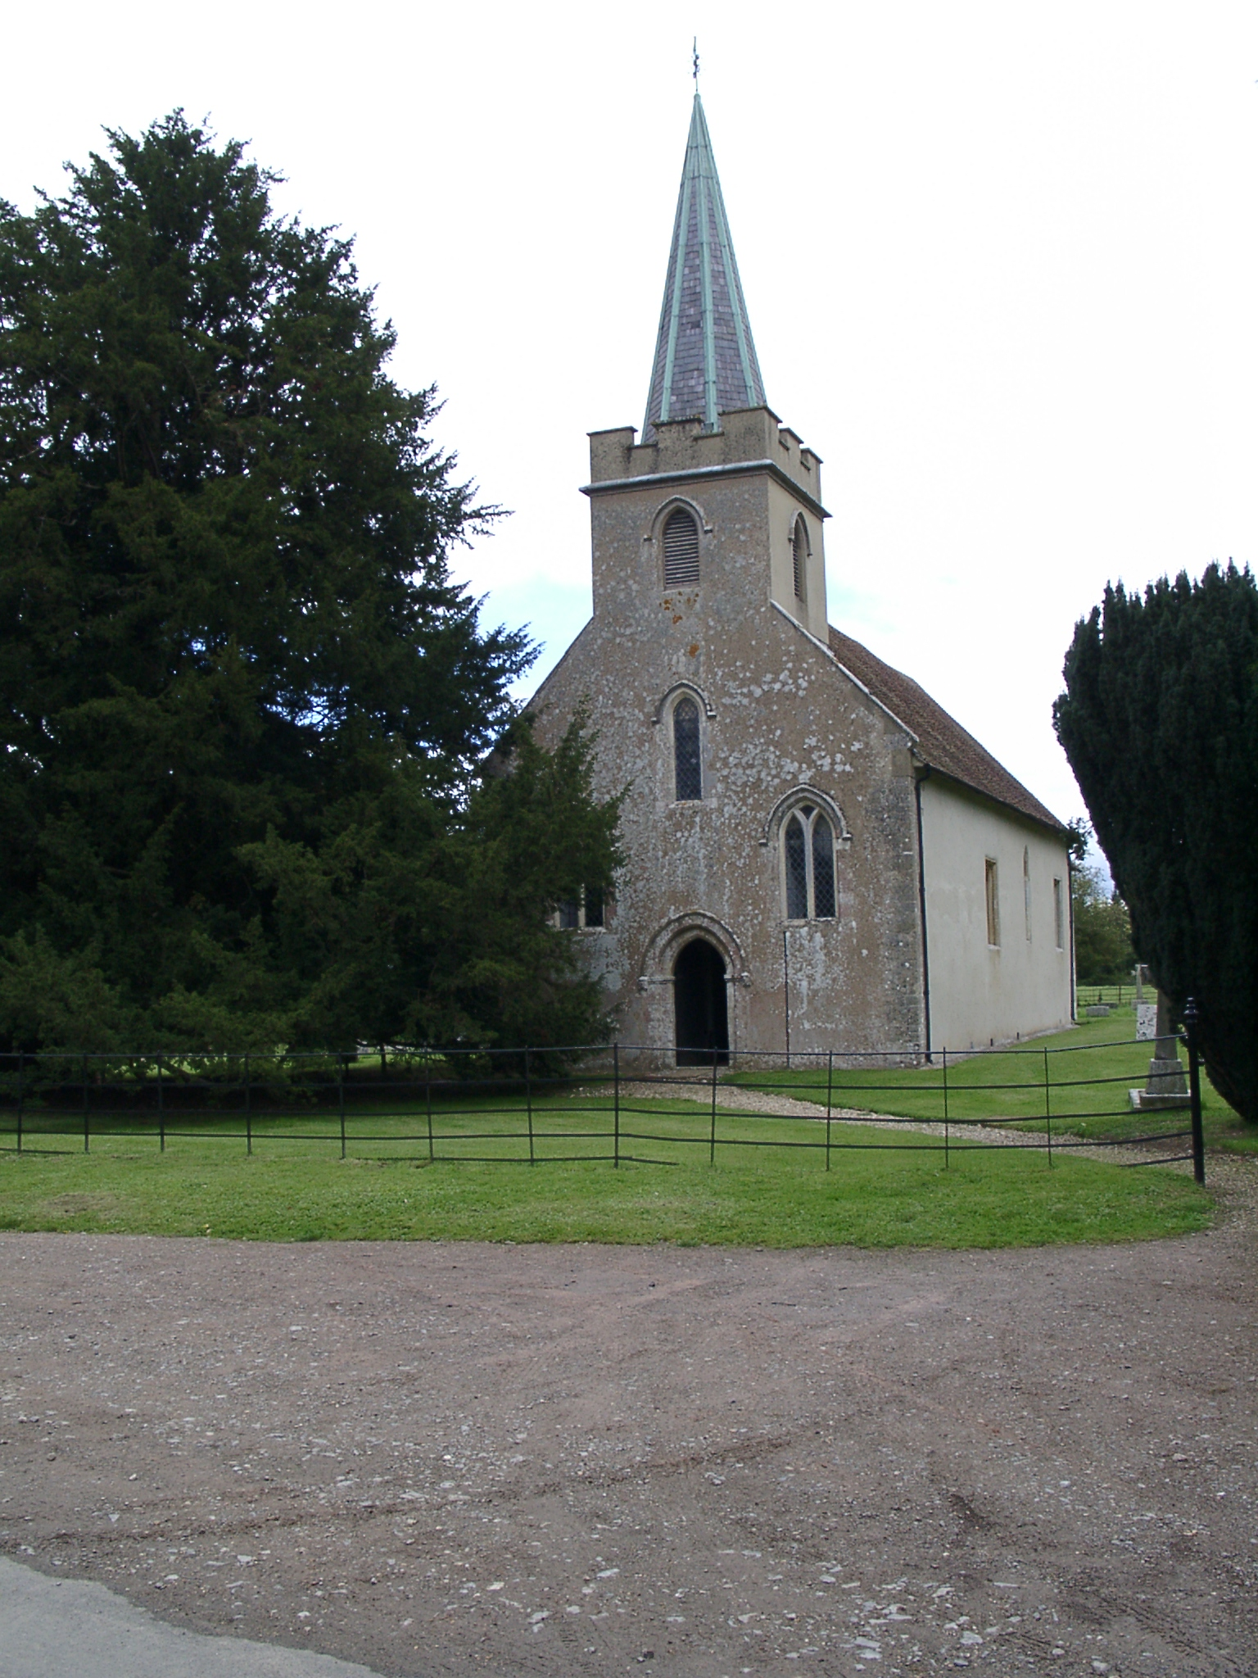

Slide 4
The Austens were moderately well off. They kept a carriage and pair and ‘enjoyed … some of the considerations usually awarded to landed proprietors’.
The household was lively and bookish.
The family also enjoyed writing and performing plays for evening entertainment.

Slide 5
When young she went to balls and picnics, and paid visits like any other girl of her class.
Once, it seems, she may have been seriously in love, but the man died.
She never married.

Slide 6
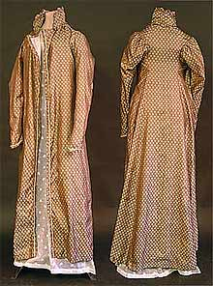
This is a photograph of a coat worn by Jane Austen.
It gives an idea of the type of clothes worn by young ladies of the time.

Slide 7
Georgian Writer
Because of the charm of her plots, their setting in merry old England, and the Victorian-styled costumes and 1850 setting used in the first film adaptation of Pride and Prejudice in 1940), you may view Austen as Victorian. (This isn't your fault . . . the 1940 film misled you!) But Jane Austen lived between 1775 and 1817, and her novels came out between 1813 and 1818, the year after her death, which places her and her work in the Georgian period of English history.

Slide 8
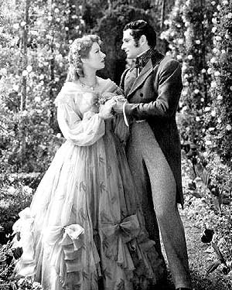
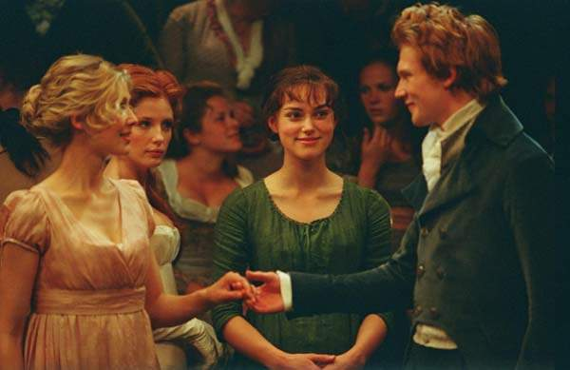
Simplicity of the
Empire line dress
Fluffy Hollywood!

Slide 9
The Regency Period
The Regency period in the United Kingdom is the period between 1811 and 1820, when King George III was deemed unfit to rule and his son, later George IV, was instated to be his proxy as Prince Regent. The term is often expanded to apply to the years between 1795 and 1837, a time characterised by distinctive fashions, politics and culture. In this sense, it can be considered to be a transitional period between "Georgian" and "Victorian" eras. The era was distinctive for its architecture, literature, fashions, and politics.

Slide 10
Austen Novels
Pride and Prejudice 1796 (Pub. 1813)
Sense and Sensibility 1797 (Pub. 1811)
Northhanger Abbey 1798 (Pub. 1818)
Mansfield Park (Pub. 1814)
Emma (Pub. 1815)
Persuasion (Pub. 1818)

Slide 11
Jane Austen Quotes.
“A lady's imagination is very rapid; it jumps from admiration to love, from love to matrimony in a moment.”
“A large income is the best recipe for happiness I ever heard of.”
“An engaged woman is always more agreeable than a disengaged. She is satisfied with herself. Her cares are over, and she feels that she may exert all her powers of pleasing without suspicion. All is safe with a lady engaged; no harm can be done.”

Slide 12
Irony
As in many of Austen’s other novels, irony is employed in Pride and Prejudice as the lens through which society and human nature are viewed. Through the novel, Austen studies social relationships in the limited society of a country neighbourhood and investigates them in detail with an often ironic and humorous eye. Note her presentation of Mr. and Mrs. Bennet, for example. Their contrasting temperaments are first shown through their manner of conversation; Mrs. Bennet chatters on while Mr. Bennet counters her talk with mildly sarcastic statements, the mocking tone of which Mrs. Bennet completely misses.

Slide 13
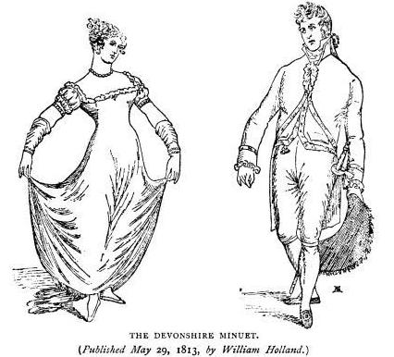
Social Customs
Dances figure prominently in Jane Austen’s novels. Whether performed in public assembly rooms in Meryton or in private at the Netherfield Ball, dances offered social opportunities for young people to mix and mingle and converse in an acceptable fashion. In an era when a young lady of good breeding was strictly chaperoned and escorted everywhere she went, she would find it difficult during a routine day to meet privately with a single gentleman, even one who was courting her.

Slide 14
Since a dance would often last for half an hour, the dancers had ample time to converse, flirt, and even touch one another in an accepted manner. A gentleman would, of course, never ask a young lady to dance unless he was first introduced to her. During this era people were often judged for their ability to dance skilfully, and a gentleman was pressured to cut a fine figure on the dance floor. Look out for Mr Collins’ dancing technique in the novel!

Slide 15
Regency social manners were all politeness and gentility. There was protocol for every social interaction; down to the way a woman holds her fan to indicate her interest in a gentleman. The social hierarchy was the core of everything, and everyone knew their place, whether they agreed with it or not. Women largely did not inherit wealth, nor were they openly allowed to find their own means; so marriage was one of the few options she had to secure a comfortable future. A marriage based on love was rarely an option for a Regency woman, income was the first consideration. It is probably why this period yielded some of the best literary romance available today.

Slide 16
Women and Marriage
http://www.pemberley.com/janeinfo/pptopic2.html#protofem3

Slide 17
This powerpoint was kindly donated to www.worldofteaching.com
http://www.worldofteaching.com is home to over a thousand powerpoints submitted by teachers. This is a completely free site and requires no registration. Please visit and I hope it will help in your teaching.

